Slide 1
MAIN PROJECT REVIEW 1 ON DISASTER PREDICTION AND RESPONSE MANAGEMENT SYSTEM

Slide 2

Gayatri Vidya Parishad College of Engineering (Autonomous) Madhurawada, Visakhapatnam – 530048 Under the esteemed guidance of Mr. K.V.S.S Prakash Assistant Professor Department of Information Technology
Project Team Members
T. Yaswanth Sai Manoj - 20131A1258
S. Vanamali - 20131A1250
Mehzabin Bano - 20131A1233
K. Vivek Babu - 20131A1221

Slide 3
CONTENTS
Abstract
Introduction
Existing System
Proposed System
Requirements Specification
Functional Requirements
Non-Functional Requirements
Software Requirements
Hardware Requirements
System Architecture and flow chart
UML Diagrams
Technologies used
Modules
Datasets Used
Project status

Slide 4
Abstract
Reliable disaster prediction portals are challenging to find, and existing platforms often lack coverage across multiple sectors. Governments and NGOs require dedicated platforms for guidance and communication during these challenging times. Our project aims to provide real-time data, communicative options, and reliable predictive analysis for disasters such as forest fires.

Slide 5
Abstract
This project introduces a predictive disaster management system that employs machine learning (ML) models to anticipate and mitigate disasters such as Forest fires. The system takes geographical data as user input to deliver accurate and timely disaster predictions.
Upon receiving the geographical details, the system intiates API calls regarding location co-ordinates and performs data acquisition, which serves as input to a trained ML model. The ML model utilizes historical and current data to generate precise predictions regarding disasters in the specified area. The project not only focuses on disaster prediction but also emphasizes the importance of proactive disaster management by generation of a Response plan.
DPRMS offers multiple features such as Emergency contacts notification and SOS calls. This innovative approach ensures the scalability and adaptability of the system across diverse geographic locations, providing a valuable tool for disaster preparedness and response efforts. By combining ML capabilities with geographic information, the project aims to contribute to the advancement of effective and data-driven disaster management strategies.

Slide 6
Introduction
DPRMS aims to enhance community resilience through an integrated platform offering a suite of features for effective disaster prediction, preparedness, safe exit plan and providing information to emergency contacts.
The system leverages real-time data sources which include historical and real-time meteorological data, Geospatial data and satellite imagery , and social media.
DPRMS incorporates machine learning models for the prediction of disasters.

Slide 7
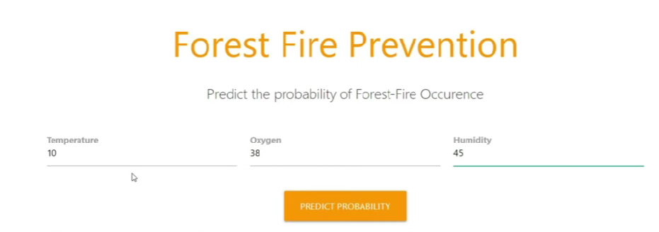
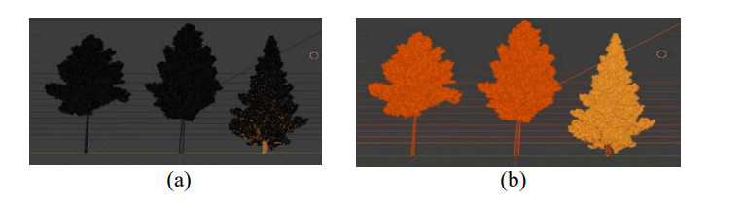
Existing System
There are disaster detectors like Forest fire prediction systems which utilize image processing for forest fire detection and systems which utilize Temperature, Oxygen and Humidity data.
These systems are incorporated into the ML module of DPRMS to predict the probability of the forest fire with maximum efficacy and precision.

Slide 8
Proposed System
Random Forest:
Hyperparameter tuning for optimal performance.
Utilize ensemble predictions for enhanced accuracy.
Implement regression forest for continuous value prediction.
Artificial Neural Networks (ANN):
Design a regression network for forest fire prediction.
Employ MLP with a sigmoid activation function.
Comparative study between Random Forest and ANN approaches.

Slide 9
Functional Requirements
Search Functionality :
DPRMS provides a search bar that filters the features such response plans and disaster specific tools(predictor , Live-data coverage, etc) and other details with the help of React .
User-friendly :
Application programming Interfaces are widely used to retrieve the data required for prediction. Hence users have the flexibility to give various inputs, DPRMS makes it easy for them to navigate, interact with, and accomplish their goals
Secure:
Further DPRMS also allows users to create an account which provides better security and specialized features such as discourse realm to the authenticated users.

Slide 10
Non-Functional Requirements
Performance :
The System response time must be quick and should render the page in optimal time.
React makes this possible as it supports reconciliation and uses virtual DOM to render the web pages.
Compatibility :
Bundlers like Parcel, Web pack are utilized that helps in making the application compatible on the older versions of the browsers.
Usability:
The system shall have a user interface that is intuitive and easy to navigate -
Component Based Architecture.

Slide 11
Software Requirements
Data Integration and APIs:
Tools and frameworks for integrating various data sources, including weather APIs, seismic data feeds, satellite imagery, and other relevant sources.
Machine Learning and Predictive Analytics:
Libraries and frameworks for implementing machine learning algorithms and predictive analytics. This may include scikit-learn, TensorFlow, or PyTorch for building predictive models.
Database Management System (DBMS):
A robust DBMS for storing and retrieving data efficiently. PostGreSQL is most suitable for handling geospatial and time-series data.
Web Development Framework :
A web development framework for building the user interface and handling server-side operations. Examples include Django, Flask (Python), Ruby on Rails (Ruby), or Node.js
Collaboration and Communication Tools:
Integration with collaboration and communication tools to facilitate coordination among disaster response teams. This could include messaging platforms, video conferencing
Version Control System: Git
Integrated Development Environment (IDE): Visual Studio Code, Sublime Text, PyCharm
Front-end Framework/Library: React, Angular, Vue.js

Slide 12
Hardware Requirements
The most common set of requirements defined by any operating system or software application is the physical computer resources, also known as hardware.
A hardware requirements list is often accompanied by a hardware compatibility list (HCL), especially in case of operating systems.
An HCL lists tested, compatible, and sometimes incompatible hardware devices for a particular operating system or application.
The following sub-sections discuss the various aspects of hardware requirements. The Hardware Interfaces required are:
RAM: Minimum 4GB or higher
SSD: 128GB
Processor: Intel i3 or an equivalent processor.

Slide 13
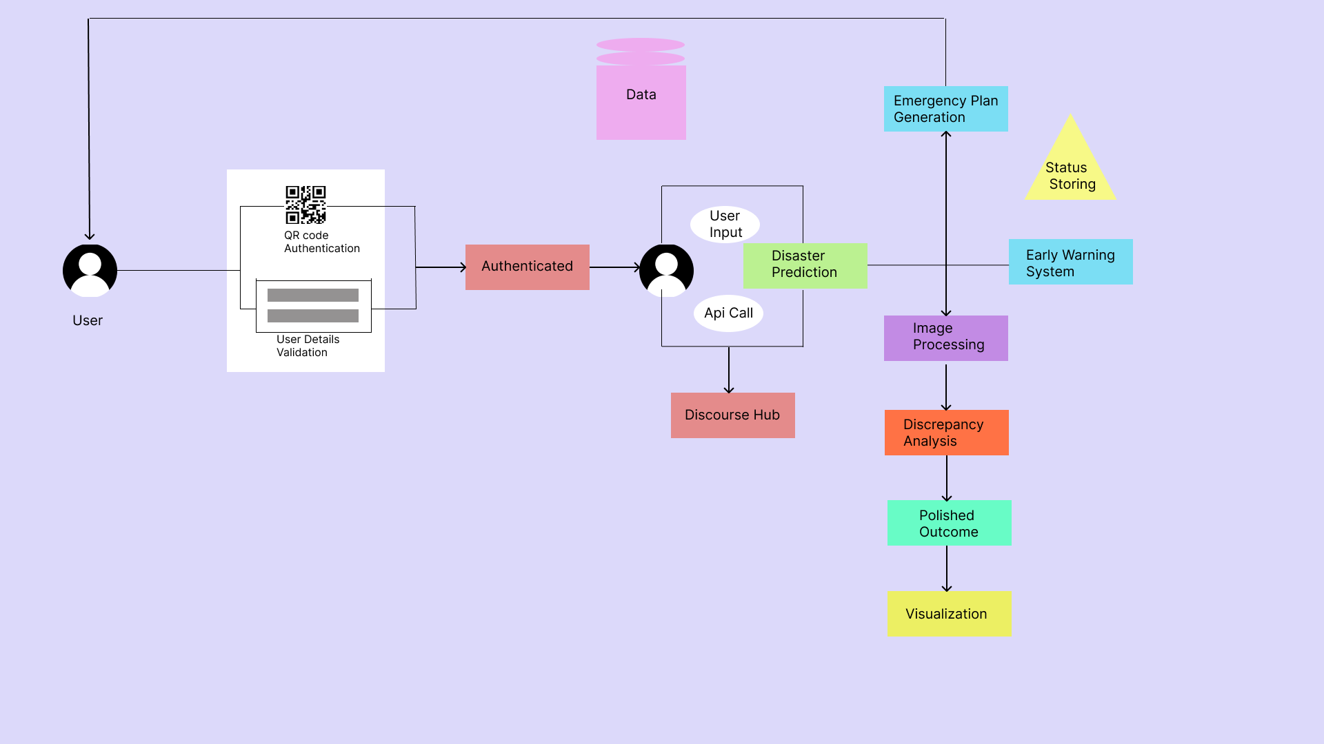
System Architecture - HLD

Slide 14
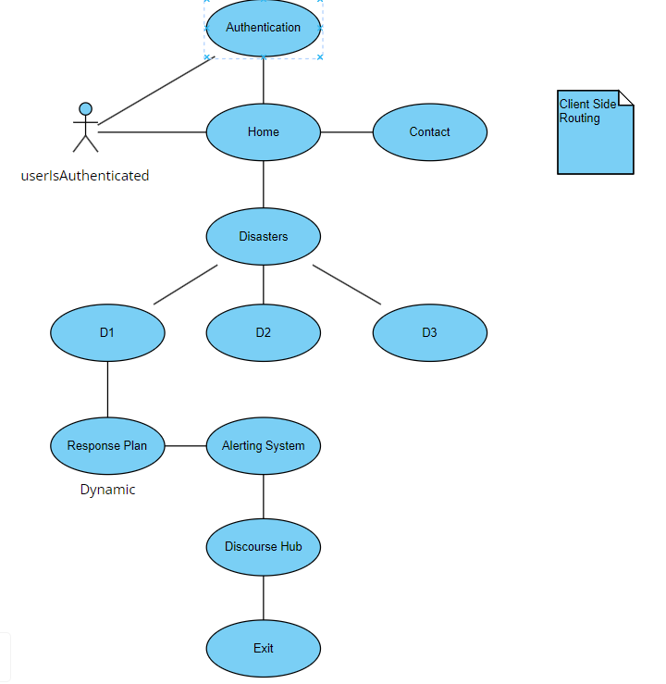
UML Diagrams – UI Rendering

Slide 15
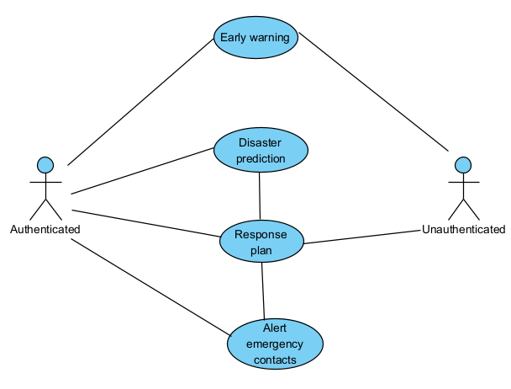
Disaster Prediction

Slide 16






Technologies Used
Building UI :
Front End : React, Tailwind CSS, Javascript.
Back End : Flask
Database : PostGreSQL
Machine Learning :
Natural Language Processing, ……..

Slide 17





Modules
Packages Used : Parcel, react-router(Client Side Routing), …….
Modules Used : Pandas,Math, scikit-learn, Os, Numpy, SciPy, PyTorch, Pickle, Seaborn, Matplotlib
Postman - To check API calls.
Git, Github - Version Control, Storing and tracking the Project.
Vercel, Netlify - Production build hosting.

Slide 18
References & Datasets
http://api.openweathermap.org/geo/1.0/direct?q={cityname},{statecode},{country code}&limit={limit}&appid={API key}
https://api.openweathermap.org/data/3.0/onecall?lat={lat}&lon={lon}&appid={APIkey}
https://www.kaggle.com/datasets/elikplim/forest-fires-data-set
https://archive.ics.uci.edu/dataset/162/forest+fires

